Slide 1

Data Integration and Large Scale Analysis 10 Distributed Data-Parallel Computation
Slides Credit: Matthias Boehm
Last update: Jan 12, 2024

Slide 2
Announcements/Org
Course Evaluation and Exam
Evaluation period: till Feb 15
Exam date: Feb 02, 3:00pm (90 min written exam)
Oral Exam for Erasmus Students
Schedule available in TeachCenter

Slide 3
Course Outline Part B: Large-Scale Data Management and Analysis
11 Distributed Stream Processing
12 Distributed Machine Learning Systems
10 Distributed Data-Parallel Computation
Compute/ Storage
09 Distributed Data Storage
08 Cloud Resource Management and Scheduling
Infra
07 Cloud Computing Fundamentals

Slide 4
Agenda
Motivation and Terminology
Data-Parallel Collection Processing
Data-Parallel DataFrame Operations
Data-Parallel Computation in SystemDS

Slide 5
Motivation and Terminology

Slide 6
Recap: Central Data Abstractions
Motivation and Terminology
#1 Files and Objects
File: Arbitrarily large sequential data in specific file format (CSV, binary, etc)
Object: binary large object, with certain meta data
#2 Distributed Collections
Logical multi-set (bag) of key-value pairs (unsorted collection)
Different physical representations
Easy distribution of pairs via horizontal partitioning (aka shards, partitions)
Can be created from single file, or directory of files (unsorted)
Key | Value
4 | Delta
2 | Bravo
1 | Alfa
3 | Charlie
5 | Echo
6 | Foxtrot
7 | Golf
1 | Alfa

Slide 7
Excursus: Nehalem Architecture
Motivation and Terminology
[Michael E. Thomadakis: The Architecture of the Nehalem Processor and Nehalem-EP SMP Platforms, Report, 2010]
Multi-core CPU
4 core w/ hyper-threading
Per core: L1i/L1d, L2 cache
Per CPU: L3 cache (8MB)
3 memory channels (8B width, max 1.333Ghz)
Pipeline
Frontend: Instruction Fetch, Pre-Decode, and Decode
Backend: Rename/Allocate, Scheduler, Execute
Out-of-Order Execution Engine (IPC=4)
128b FP Multiply
128b FP Add
QPI … Quick Path Interconnect
Notes:
4 cpu cores w/ht to which OS seems like virtual cores
L1 cache is split into instruction and data cache 64 KB
L2 256 kB 0 8 MB
128 bit registers -> 2 FP64 op, per cycle 4

Slide 8
Terminology
Motivation and Terminology
Single Data
Multiple Data
Flynn’s Classification
SISD, SIMD
(MISD), MIMD
Example: SIMD Processing
Streaming SIMD Extensions (SSE)
Process the same operation on multiple elements at a time (packed vs scalar SSE instructions)
Data parallelism (aka: instruction-level parallelism)
Example: VFMADD132PD
SISD
(uni-core)
SIMD (vector)
Single Instruction
[Michael J. Flynn, Kevin W. Rudd: Parallel Architectures. ACM Comput. Surv. 28(1) 1996]
MISD (pipelining)
MIMD (multi-core)
Multiple Instruction
2009 Nehalem: 128b (2xFP64)
2012 Sandy Bridge: 256b (4xFP64)
2017 Skylake: 512b (8xFP64)
c = _mm512_fmadd_pd(a, b);
a
b
c
Notes:
8 double precision operations

Slide 9
Terminology cont.
Motivation and Terminology
Distributed, Data-Parallel Computation
Parallel computation of function foo() ➔ single instruction
Collection X of data items (key-value pairs) ➔ multiple data
Data parallelism similar to SIMD but more coarse-grained notion of “instruction” and “data” ➔ SPMD (single program, multiple data)
Additional Terminology
BSP: Bulk Synchronous Parallel (global barriers)
ASP: Asynchronous Parallel (no barriers, often with accuracy impact)
SSP: Stale-synchronous parallel (staleness constraint on fastest-slowest)
Other: Fork&Join, Hogwild!, event-based, decentralized
Beware: data parallelism used in very different contexts (e.g., Param Server)
Y = X.map(x -> foo(x))
[Frederica Darema: The SPMD Model : Past, Present and Future. PVM/MPI 2001]
Notes:
UDF centric programming model

Slide 10
Data-Parallel Collection Processing

Slide 11

Hadoop History and Architecture
Data-Parallel Collection Processing
[Jeffrey Dean, Sanjay Ghemawat: MapReduce: Simplified Data Processing on Large Clusters. OSDI 2004]
Recap: Brief History
Google’s GFS [SOSP’03] + MapReduce → Apache Hadoop (2006)
Apache Hive (SQL), Pig (ETL), Mahout (ML), Giraph (Graph)
Hadoop Architecture / Eco System
Management (Ambari)
Coordination / workflows (Zookeeper, Oozie)
Storage (HDFS)
Resources (YARN) [SoCC’13]
Processing (MapReduce)
Worker Node 1
Worker Node n
MR AM
MR task
MR task
MR task
Head Node
MR task
MR task
MR task
MR task
Resource Manager
Node Manager
Node Manager
NameNode
MR Client
DataNode
DataNode
1
3
2
3
2
9
Notes:
Basic history goes back to very impactful Map Reduce 2003 – 2004, 2006 opensource
Application scheduling and task scheduling
Doug Cutting and Mike Cafarella

Slide 12
MapReduce – Programming Model
Data-Parallel Collection Processing
Overview Programming Model
Inspired by functional programming languages
Implicit parallelism (abstracts distributed storage and processing)
Map function: key/value pair → set of intermediate key/value pairs
Reduce function: merge all intermediate values by key
Example
SELECT Dep, count(*) FROM csv_files GROUP BY Dep
Name | Dep
X | CS
Y | CS
A | EE
Z | CS
map(Long pos, String line) {
parts ← line.split(“,”)
emit(parts[1], 1)
}
CS | 1
CS | 1
EE | 1
CS | 1
reduce(String dep, Iterator<Long> iter) {
total ← iter.sum();
emit(dep, total)
}
Collection of key/value pairs
CS | 3
EE | 1

Slide 13
MapReduce – Execution Model
Data-Parallel Collection Processing
#1 Data Locality (delay sched., write affinity)
#2 Reduced shuffle (combine)
#3 Fault tolerance (replication, attempts)
Input CSV files (stored in HDFS)
Map-Phase
map task
[Reduce-Phase]
Output Files (HDFS)
CSV File 1
Split 11
map task
Split 12
reduce task
Out 1
Split 21
map task
CSV File 2
reduce task
Out 2
Split 22
map task
reduce task
Out 3
CSV File 3
Split 31
map task
Split 32
map task
Shuffle, Merge, [Combine]
Sort, [Combine], [Compress]
w/ #reducers = 3

Slide 14
MapReduce – Query Processing
Data-Parallel Collection Processing
Basic Unary Operations
Selections (brute-force), projections
Ordering (e.g., TeraSort): Sample, pick k quantiles; shuffle-based partition sort
Additive and semi-additive aggregation with grouping, distinct
Binary Operations
Set operations (union, intersect, difference) and joins
Different physical operators for R ⨝ S
Broadcast join: broadcast S, build HT S, map-side HJOIN
Repartition join: shuffle (repartition) R and S, reduce-side MJOIN
Improved repartition join: avoid buffering via key-tag sorting
Directed join (pre/co-partitioned): map-only, R input, S read side-ways
Hybrid SQL-on-Hadoop Systems [VLDB’15]
E.g.: Hadapt (HadoopDB), Impala, IBM BigSQL, Presto, Drill, Actian
[Spyros Blanas et al.: A comparison of join algorithms for log processing in MapReduce. SIGMOD 2010]
Notes:
Shuffling for uniondistinct
Join are time consuming
Easy is broadcast join
Repartition join: each map task tags the record with its originating table, and outputs the extracted join key and the tagged record as a (key, value) pair. The outputs are then partitioned, sorted and merged by the framework. All the records for each join key are grouped together and eventually fed to a reducer. For each join key, the reduce function first separates and buffers the input records into two sets according to the table tag and then performs a cross-product between records in these sets.
Improved Repartition Join: The table tags are generated in a way that ensures records from R will be sorted ahead of those from L on a given join key. The grouping function in the reducer is also customized so that records are grouped on just the join key. Finally, as records from the smaller table R are guaranteed to be ahead of those from L for a given join key, only R records are buffered and L records are streamed to generate the join output

Slide 15

Spark History and Architecture
Data-Parallel Collection Processing
Summary MapReduce
Large-scale & fault-tolerant processing w/ UDFs and files ➔ Flexibility
Restricted functional APIs ➔ Implicit parallelism and fault tolerance
Criticism: #1 Performance, #2 Low-level APIs, #3 Many different systems
Evolution to Spark (and Flink)
Spark [HotCloud’10] + RDDs [NSDI’12] → Apache Spark (2014)
Design: standing executors with in-memory storage, lazy evaluation, and fault-tolerance via RDD lineage
Performance: In-memory storage and fast job scheduling (100ms vs 10s)
APIs: Richer functional APIs and general computation DAGs, high-level APIs (e.g., DataFrame/Dataset), unified platform
➔ But many shared concepts/infrastructure
Implicit parallelism through dist. collections (data access, fault tolerance)
Resource negotiators (YARN, Mesos, Kubernetes)
HDFS and object store connectors (e.g., Swift, S3)
Notes:
Evolution to more modern DP computation frameworks

Slide 16
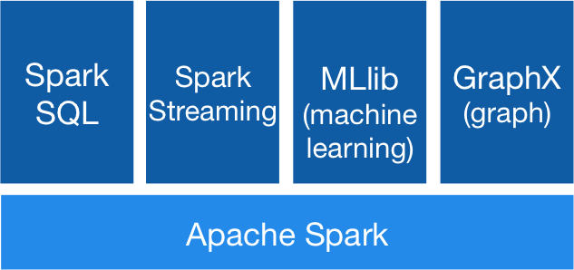


Spark History and Architecture, cont.
Data-Parallel Collection Processing
High-Level Architecture
Different language bindings: Scala, Java, Python, R
Different libraries: SQL, ML, Stream, Graph
Spark core (incl RDDs)
Different cluster managers: Standalone, Mesos, Yarn, Kubernetes
Different file systems/ formats, and data sources: HDFS, S3, SWIFT, DBs, NoSQL
Focus on a unified platform for data-parallel computation (Apache Flink w/ similar goals)
[https://spark.apache.org/]
Standalone
MESOS
YARN
Kubernetes

Slide 17
Spark Resilient Distributed Datasets (RDDs)
Data-Parallel Collection Processing
RDD Abstraction
Immutable, partitioned collections of key-value pairs
Coarse-grained deterministic operations (transformations/actions)
Fault tolerance via lineage-based re-computation
Operations
Transformations: define new RDDs
Actions: return result to driver
Distributed Caching
Use fraction of worker memory for caching
Eviction at granularity of individual partitions
Different storage levels (e.g., mem/disk x serialization x compression)
JavaPairRDD<MatrixIndexes,MatrixBlock>
Type | Examples
Transformation (lazy) | map, hadoopFile, textFile, flatMap, filter, sample, join, groupByKey, cogroup, reduceByKey, cross, sortByKey, mapValues
Action | reduce, save, collect, count, lookupKey
Node1
Node2
Notes:
Collect: convert data to list and bring to driver process
Persist
IN_MEMORY, MEMORY_AND_DESK

Slide 18
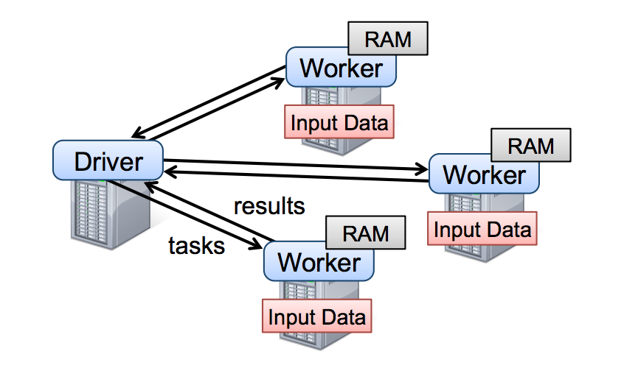
Spark Resilient Distributed Datasets (RDDs), cont.
Data-Parallel Collection Processing
Lifecycle of an RDD
Note: can’t broadcast an RDD directly
X.filter(foo())
X.mapValues(foo())
X.reduceByKey(foo())
X.cache()
sc.parallelize(lst)
Local Data
(value, collection)
Distributed Collection
lst = X.collect() v = X.reduce(foo())
sc.hadoopFile(f)
sc.textFile(f)
X.saveAsObjectFile(f)
X.saveAsTextFile(f)
File on DFS

Slide 19
Spark Partitions and Implicit/Explicit Partitioning
Data-Parallel Collection Processing
Spark Partitions
Logical key-value collections are split into physical partitions
Partitions are granularity of tasks, I/O, shuffling, evictions
Partitioning via Partitioners
Implicitly on every data shuffling
Explicitly via R.repartition(n)
Partitioning-Preserving
All operations that are guaranteed to keep keys unchanged (e.g. mapValues(), mapPartitions() w/ preservesPart flag)
Partitioning-Exploiting
Join: R3 = R1.join(R2)
Lookups: v = C.lookup(k)
~128MB
Example Hash Partitioning:
For all (k,v) of R: pid = hash(k) % n
Hash partitioned
⋈
⋈
0: 8, 1, 6
0: 1, 2
% 3
0: 3, 6
0: 6, 3
2: 2, 3, 4
2: 3, 4
2: 2, 5, 8
2: 5, 2
1: 7, 5
1: 5, 6
1: 4, 7, 1
1: 4, 1
Notes:
Large RDD is partitioned into actual physical partitions of 128 MBs
Partitions are granularity of spawning tasks, performing I/O and evicting to disk and shuffling
Use hashpartition

Slide 20
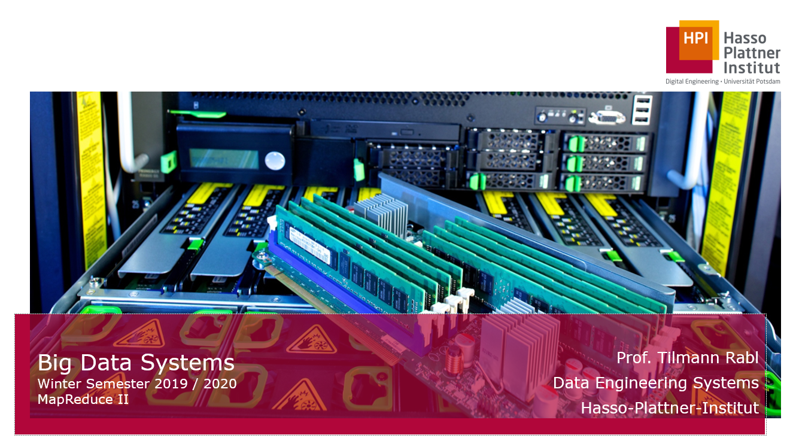
Spark Scheduling Process
Data-Parallel Collection Processing
[Tilmann Rabl: Big Data Systems, HPI WS2019/20]
RDD Objects
DAGScheduler
TaskScheduler
Workers
Scheduler Backend
Threads
DAG
TaskSet
Task
Block manager
rdd1.join(rdd2) .reduceByKey(…)
.filter(…)
split graph into stages of tasks
launch tasks at workers
execute tasks
build operator DAG
submit each stage as ready
retry failed or straggling tasks
store and serve blocks
Notes:
DAG scheduler takes the lineage graphs of partitions and schedule them with yarn
Block manager info of tasks hold pointers to partitions and terminate if any of them take more memory

Slide 21
Spark Lazy Evaluation, Caching, and Lineage
Data-Parallel Collection Processing
A
B
partitioning- aware
G
Stage 1
groupBy
C
D
F
reduce
map
union
E
join
Stage 2
Stage 3
cached
[Matei Zaharia, Mosharaf Chowdhury, Tathagata Das, Ankur Dave, Justin Ma, Murphy McCauly, Michael J. Franklin, Scott Shenker, Ion Stoica: Resilient Distributed Datasets: A Fault-Tolerant Abstraction for In-Memory Cluster Computing. NSDI 2012]
Notes:
Stages are executed in Bulk-Synchronous manner
Notes:
Dryad-­‐like DAGs
Pipelines functions within a stage
Locality & data reuse aware
Partitioning-­‐aware to avoid shuffles

Slide 22
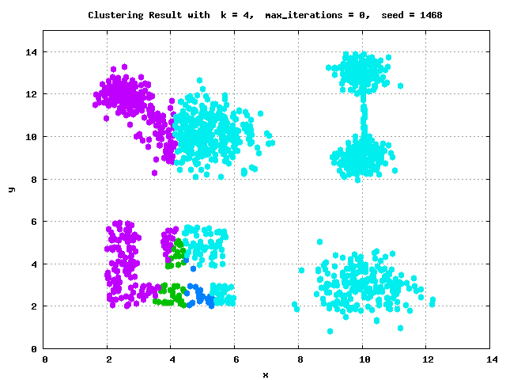
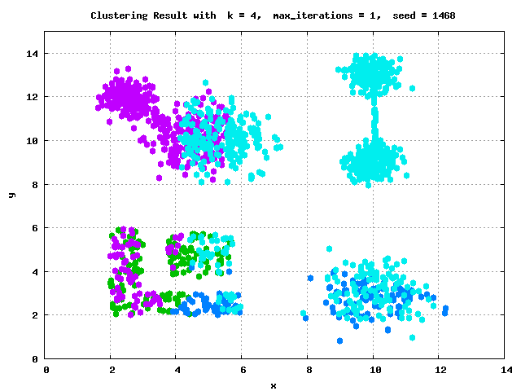
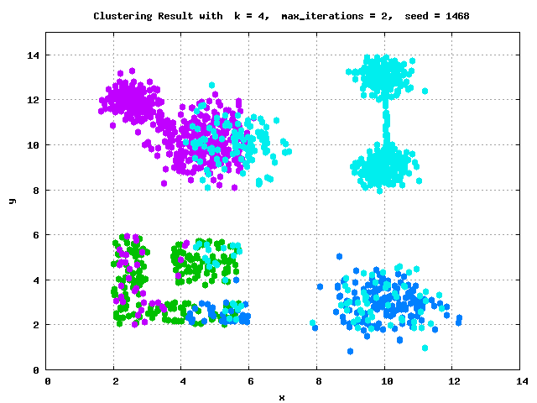
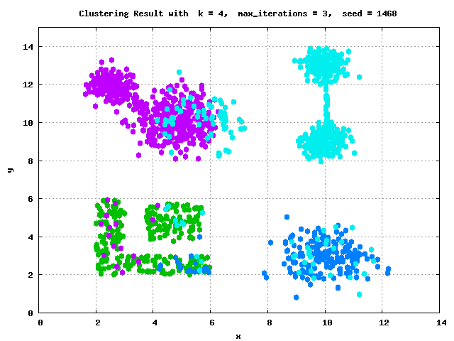
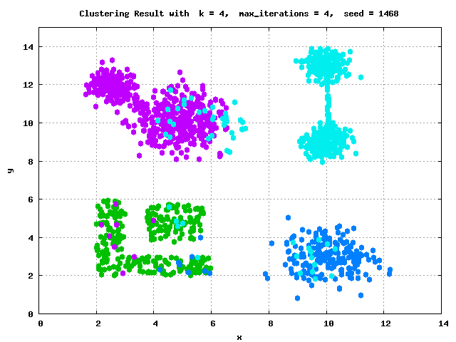

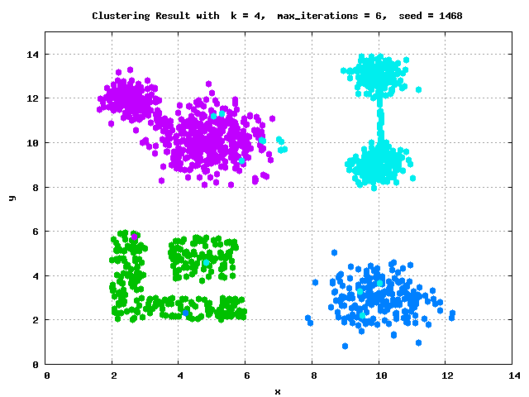




Example: k-Means Clustering
Data-Parallel Collection Processing
k-Means Algorithm
Given dataset D and number of clusters k, find cluster centroids (“mean” of assigned points) that minimize within-cluster variance
Euclidean distance: sqrt(sum((a-b)^2))
Pseudo Code
function Kmeans(D, k, maxiter) {
C‘ = randCentroids(D, k);
C = {};
i = 0; //until convergence
while( C‘ != C & i<=maxiter ) {
C = C‘;
i = i + 1;
A = getAssignments(D, C);
C‘ = getCentroids(D, A, k);
}
return C‘
}

Slide 23
Example: K-Means Clustering in Spark
Data-Parallel Collection Processing
// create spark context (allocate configured executors)
JavaSparkContext sc = new JavaSparkContext();
// read and cache data, initialize centroids
JavaRDD<Row> D = sc.textFile(“hdfs:/user/mboehm/data/D.csv“)
.map(new ParseRow()).cache(); // cache data in spark executors
Map<Integer,Mean> C = asCentroidMap(D.takeSample(false, k));
// until convergence
while( !equals(C, C2) & i<=maxiter ) {
C2 = C; i++;
// assign points to closest centroid, recompute centroid
Broadcast<Map<Integer,Row>> bC = sc.broadcast(C)
C = D.mapToPair(new NearestAssignment(bC))
.foldByKey(new Mean(0), new IncComputeCentroids())
.collectAsMap();
}
return C;
Note: Existing library algorithm [https://github.com/apache/spark/blob/master/mllib/src/ main/scala/org/apache/spark/mllib/clustering/KMeans.scala]
Notes:
Spark Local Mode
Download and unzip Spark https://spark.apache.org/downloads.html, or pull dependency into IDE project via maven or similar tools
Setup prerequisites and path variables
Test spark-shell, spark-submit, or in your IDE
NOTE: in local mode, operations run in driver JVM and I/O to local FS
Amazon AWS EMR (Elastic Map Reduce)

Slide 24
Data-Parallel DataFrame Operations

Slide 25
Origins of DataFrames
Data-Parallel DataFrame Operations
Recap: Data Preparation Problem
80% Argument: 80-90% time for finding, integrating, cleaning data
Data scientists prefer scripting languages and in-memory libraries
R and Python DataFrames
R data.frame/dplyr and Python pandas DataFrame for seamless data manipulations (most popular packages/features)
DataFrame: table with a schema
Descriptive stats and basic math, reorganization, joins, grouping, windowing
Limitation: Only in-memory, single-node operations
Example Pandas
import pandas as pd
df = pd.read_csv(‘data/tmp1.csv’, index_col=2)
df.head() # df w/ indexes A-Z
df = pd.concat(df, df[[‘A’,’C’]], axis=0)

Slide 26
Spark DataFrames and DataSets
Data-Parallel DataFrame Operations
Overview Spark DataFrame
DataFrame is distributed collection of rows with named/typed columns
Relational operations (e.g., projection, selection, joins, grouping, aggregation)
DataSources (e.g., json, jdbc, parquet, hdfs, s3, avro, hbase, csv, cassandra)
DataFrame and Dataset APIs
DataFrame was introduced as basis for Spark SQL
DataSets allow more customization and compile-time analysis errors (Spark 2)
Example DataFrame
DataFrame = Dataset[Row]
logs = spark.read.format("json").open("s3://logs")
logs.groupBy(logs.user_id).agg(sum(logs.time))
.write.format("jdbc").save("jdbc:mysql//...")
[Michael Armbrust: Structuring Apache Spark – SQL, DataFrames, Datasets, and Streaming, Spark Summit 2016]
→ PySpark

Slide 27
SparkSQL and DataFrame/Dataset
Data-Parallel DataFrame Operations
Overview SparkSQL
Shark (~2013): academic prototype for SQL on Spark
SparkSQL (~2015): reimplementation from scratch
Common IR and compilation of SQL and DataFrame operations
Catalyst: Query Planning
Performance features
#1 Whole-stage code generation via Janino
#2 Off-heap memory (sun.misc.Unsafe) for caching and certain operations
#3 Pushdown of selection, projection, joins into data sources (+ join ordering)
[Michael Armbrust et al.: Spark SQL: Relational Data Processing in Spark. SIGMOD 2015]

Slide 28

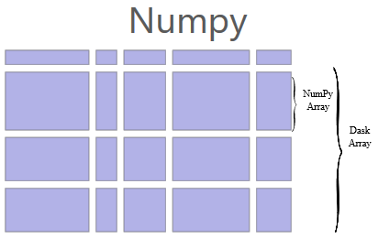
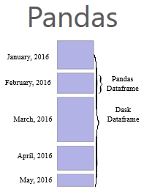
Dask
Data-Parallel DataFrame Operations
[Matthew Rocklin: Dask: Parallel Computation with Blocked algorithms and Task Scheduling, Python in Science 2015]
[Dask Development Team: Dask: Library for dynamic task scheduling, 2016, https://dask.org]
Overview Dask
Multi-threaded and distributed operations for arrays, bags, and dataframes
dask.array: list of numpy n-dim arrays
dask.dataframe: list of pandas data frames
dask.bag:unordered list of tuples (second order functions)
Local and distributed schedulers: threads, processes, YARN, Kubernetes, containers, HPC, and cloud, GPUs
Execution
Lazy evaluation
Limitation: requires static size inference
Triggered via compute()
import dask.array as da
x = da.random.random(
(10000,10000), chunks=(1000,1000))
y = x + x.T
y.persist() # cache in memory
z = y[::2, 5000:].mean(axis=1) # colMeans
ret = z.compute() # returns NumPy array
Notes:
Note: somewhat in competition w/ PySpark (but not out-of-core)
NumPy syntax: y[::2, 5000:] -> every other row, columns 5001-10000

Slide 29

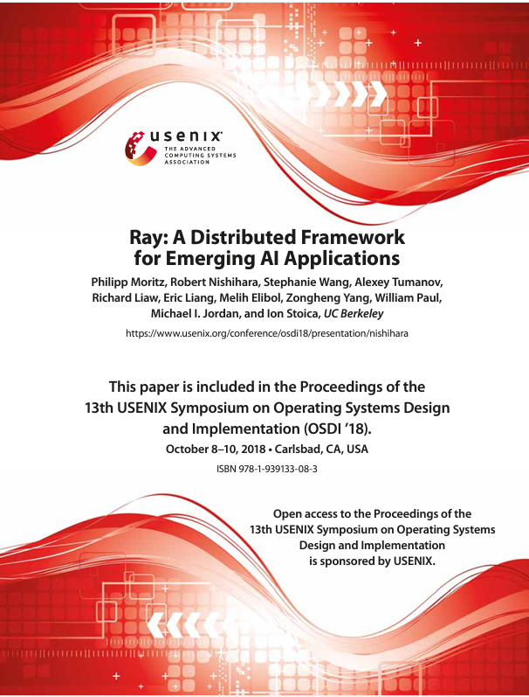
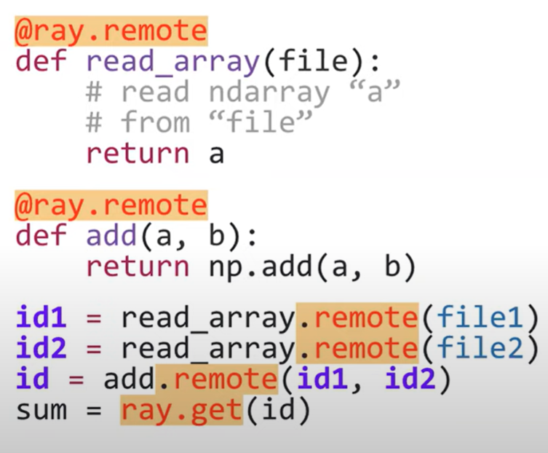
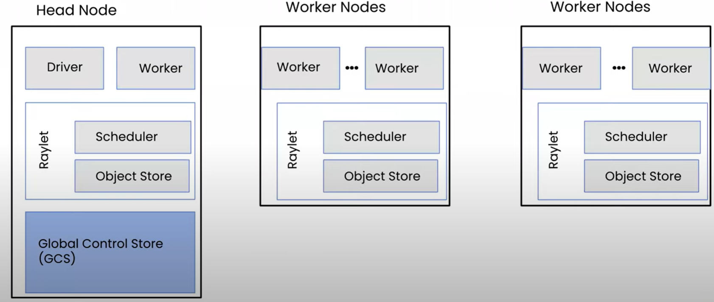
Ray
Data-Parallel DataFrame Operations
[Philipp Moritz et al.: Ray: A Distributed Framework for Emerging AI Applications, OSDI 2018]
Overview Ray
Universal framework for distributed computing
Scale AI and Python workloads
AIR-AI runtime, set of ML libraries
Ray Data, RLib, Ray Train,
Ray Batch Predictor, Ray Tune, Ray Serve
Architecture
GCS, Raylet, Object Store (Redis)
Parallel Task
Stateless units
Objects or Futures
Distributed objects
Actors
Stateful services
message passing
Notes:
Ray on Dask
Python function -> Task
Python class -> Actor

Slide 30
Data-Parallel Operations in SystemDS / DAPHNE
[Matthias Boehm et al.: SystemDS: A Declarative Machine Learning System for the End-to-End Data Science Lifecycle. CIDR 2020]
[Matthias Boehm et al.: SystemML: Declarative Machine Learning on Spark. PVLDB 9(13) 2016]
[Amol Ghoting et al.: SystemML: Declarative Machine Learning on MapReduce. ICDE 2011]

Slide 31
Background: Matrix Formats
Data-Parallel Operations in SystemDS / DAPHNE
Example 3x3 Matrix
Matrix Block (m x n)
A.k.a. tiles/chunks, most operations defined here
Local matrix: single block, different representations
Common Block Representations
Dense (linearized arrays)
MCSR (modified CSR)
CSR (compressed sparse rows), CSC
COO (Coordinate matrix)
.7
.1
.2
.4
.3
MCSR
CSR
COO
0
2
0
0
.7
0
0
.7
Dense (row-major)
.7
.1
2
2
.1
0
2
.1
.7
0
.1
.2
.4
0
0
.3
0
0
1
4
0
.2
1
0
.2
.2
.4
O(mn)
5
1
.4
1
1
.4
1
1
.3
2
1
.3
.3
O(m + nnz(X))
O(nnz(X))

Slide 32
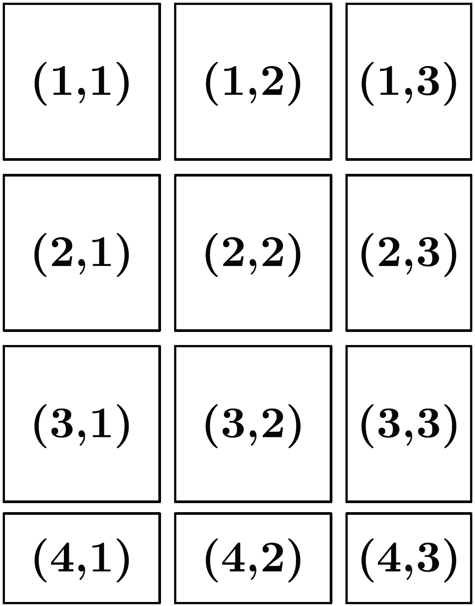
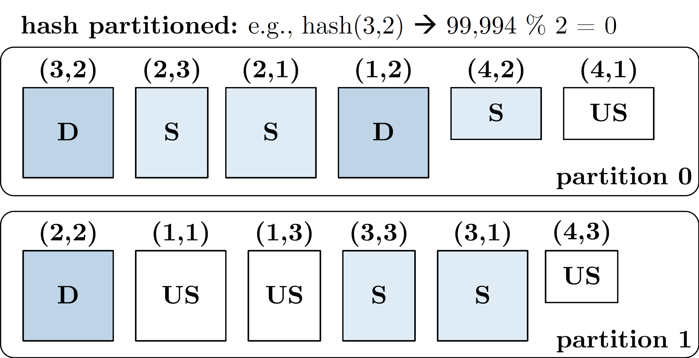
Distributed Matrix Representations
Data-Parallel Operations in SystemDS / DAPHNE
Logical Blocking 3,400x2,700 Matrix (w/ B_{c}=1,000)
Collection of “Matrix Blocks” (and keys)
Bag semantics (duplicates, unordered)
Logical (Fixed-Size) Blocking
+ join processing / independence - (sparsity skew)
E.g., SystemML/SystemDS on Spark: JavaPairRDD<MatrixIndexes,MatrixBlock>
Blocks encoded independently (dense/sparse)
Partitioning
Logical Partitioning (e.g., row-/column-wise)
Physical Partitioning (e.g., hash / grid)
PartitionPruning for Indexing
Physical Blocking and Partitioning

Slide 33
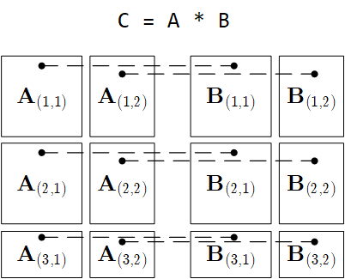
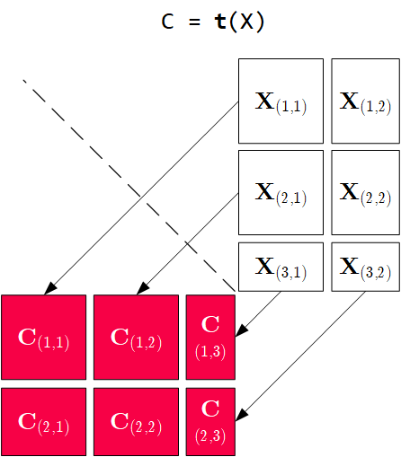
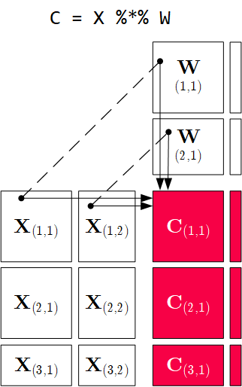
Distributed Matrix Operations
Data-Parallel Operations in SystemDS / DAPHNE
Elementwise Multiplication (Hadamard Product)
Matrix Multiplication
Transposition
Note: also with row/column vector rhs
Note: 1:N join

Slide 34
Summary and Q&A
Motivation and Terminology
Data-Parallel Collection Processing
Data-Parallel DataFrame Operations
Data-Parallel Computation in SystemDS / DAPHNE
Next Lectures
12 Distributed Stream Processing [Jan 19]
13 Distributed Machine Learning Systems [Jan 19]
Q&A Session including sample exam questions

